Slide 1
Lecture 7
All about processes

Slide 2
Outline
Processes and threads
Representing and managing tasks (Linux)
Process creation
Context switching
Digression: keeping time
Process scheduling

Slide 3
Process, threads, tasks
A process is an instance of a program in execution
It is also the entity to which the OS allocate resources to
A process can have multiple threads of control
Main different: threads share the same virtual address space among other OS resources, processes do not
Threads may be user level
Modern Linux do not draw a clear line between processes and threads – they are all called tasks
Process is a task with a single thread
A process can have several tasks
Tasks are scheduling entities in Linux
Sometimes referred to as lightweight processes

Slide 4
Pthreads
POSIX threads – the standard for multithreaded programming
Many programming languages and systems have a notion of threading. Not to be confused with OS threads.

Slide 5
Normal vs Real-time Process
Real-time processes have deadlines to meet
Example: must run for x microseconds every y millisecond
Translates to scheduling constraints
Normal (regular) process has no such requirements
To fully support real-time tasks, a real-time OS (RTOS) is required
Eg., WindRiver, RTLinux
Mainstream OS like Linux supports some real-time processes but not completely a RTOS

Slide 6
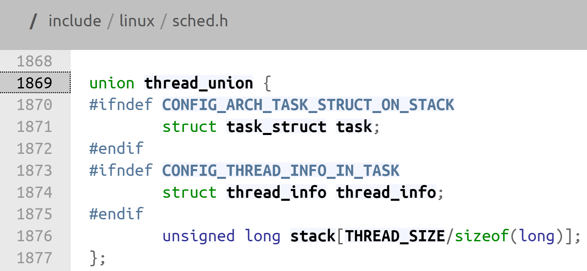
Information about processes
Depends on kernel version
In 5.16.1, a task is represented by:
task_struct
Traditional called the process control block (PCB)
Hold all information about a process/task
thread_info
Co-located with the per thread kernel stack
Used to hold the architecture dependent info
Now holds status flags that are used often
thread_struct
Located at the end of task_struct
Hold architecture dependent info such as register states etc.

Slide 7
Recall: Linux’s stacks
sp0 is used for hardware entry into the kernel
Pointed to by per CPU TSS, resides in CPU entry area
IST stacks used for special exceptions in x86-64
Per CPU hardirq_stack used for external interrupts
Keep it clear of any (user) task or threads
Per thread kernel stack a.k.a. process kernel stack
For processing in kernel mode within the context of a process
Top pointed to by per CPU variable cpu_current_top_of_stack
Used for syscall entry

Slide 8
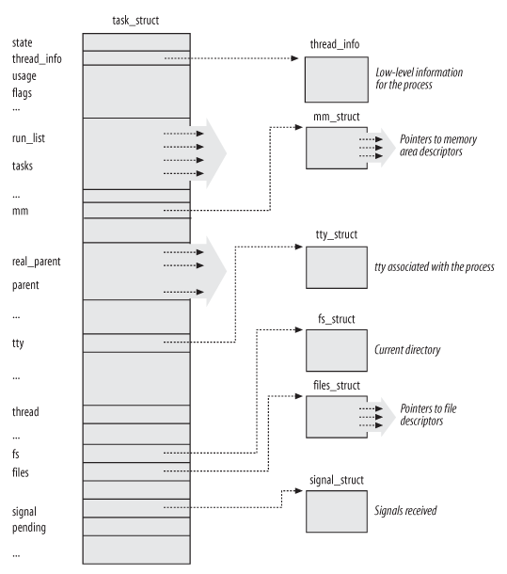
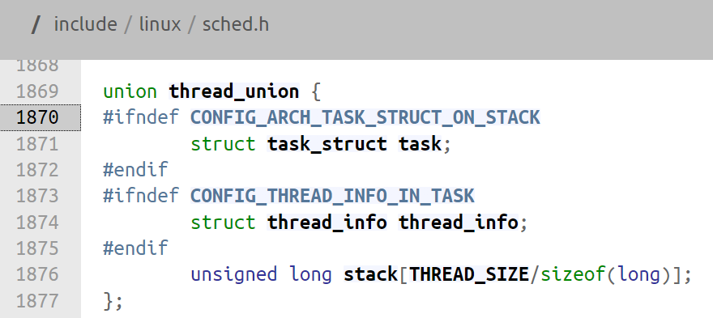
Tasks in Linux
task_struct defined in include/linux/sched.h
Multiple tasks can share the same virtual space.

Slide 9
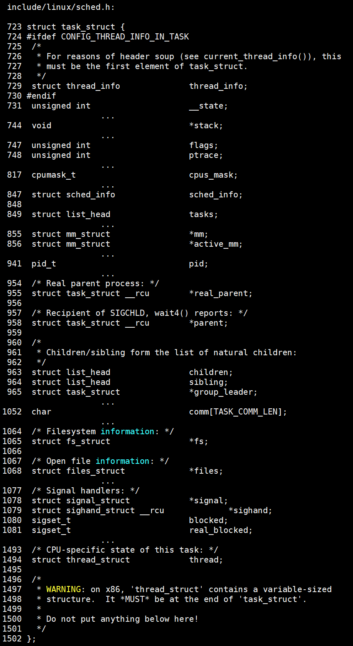
Layout
Processes are dynamic, so descriptors are kept in dynamic memory.
thread_info designed to fit a cache line for kernel entry purpose
arch/x86/include/asm/thread_info.h
thread_struct contains all the detailed architecture dependent information about the thread
arch/x86/include/asm/processor.h

Slide 10
Task States in Linux
TASK_RUNNING – task is either executing on a CPU or is awaiting execution
TASK_INTERRUPTIBLE – task is sleeping but can be awaken by an interrupt
TASK_UNINTERRUPTIBLE – task is sleeping. Any interrupt delivered to it will not change its state.
Seldom used but needed for certain critical wait situations
TASK_STOPPED – task is stopped
TASK_TRACED – task is stopped by a debugger (using ptrace)

Slide 11
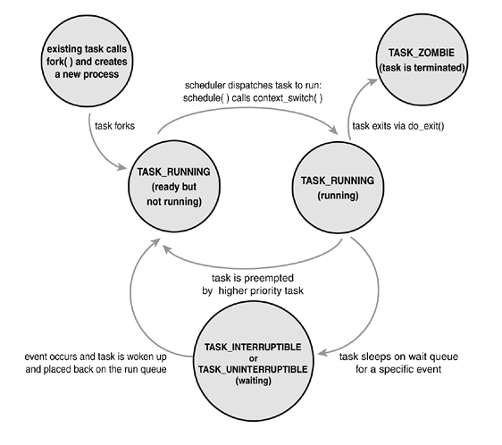
State transition

Slide 12
Process Identification
Processes in Unix (including Linux) is identified by a process identifier
It is merely a number that wraps around 32-bit
Each process also has user and group identifiers that are used for access control

Slide 13
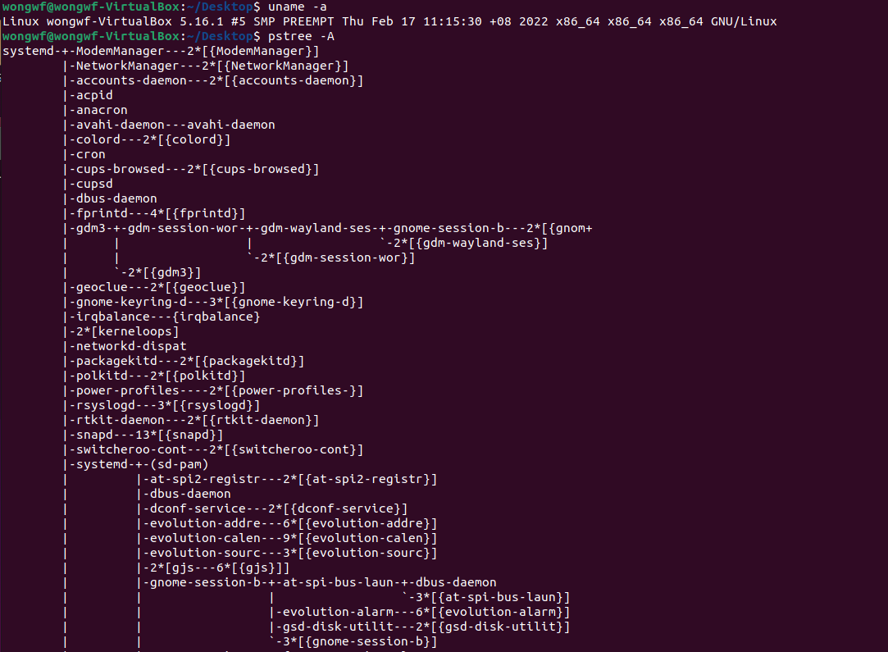
Process hierarchy
All processes (in Linux) forms a tree
Every process (except init) has exactly one parent
The first task is in variable init_task
A process can be the parent of several child processes
A process awaiting full termination (and is no longer runnable) is a zombie process
A process whose parent died is an orphaned process
An orphaned process will be automatically adopted by init

Slide 14
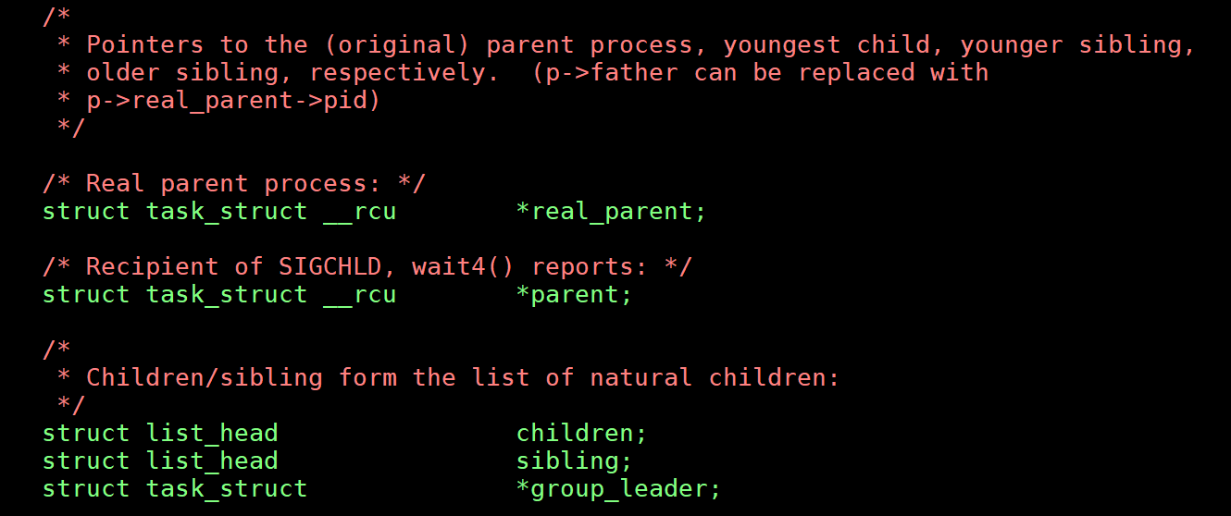
Parents of Processes
Real parent: The process descriptor of the process that created it or to the descriptor of process 1 if the parent process no longer exists.
Parent: The process that will handle the termination signal of the child. May be different due to tracing.
man ptrace

Slide 15
Process Creation
Processes are created frequently
We want to do it quickly
In Linux, process creation is actually process duplication
A child process starts life as a clone of the parent
Three tricks of Linux kernel
Copy-on-Write (COW)
Lightweight process creation using clone()
vfork()

Slide 16
Copy-on-Write (COW)
Parent and the child process initially share same physical pages
Linux terminology: physical pages are called page frames or just frames; “pages” refers to virtual pages.
As long as they are shared, they cannot be modified
Any attempt to write a shared frame triggers an exception
Kernel duplicates the page into a new page frame and marks it as writable.
Original page frame remains write-protected: kernel checks whether the writing process is the only owner of the page frame. If so, makes the page frame writable for the process

Slide 17
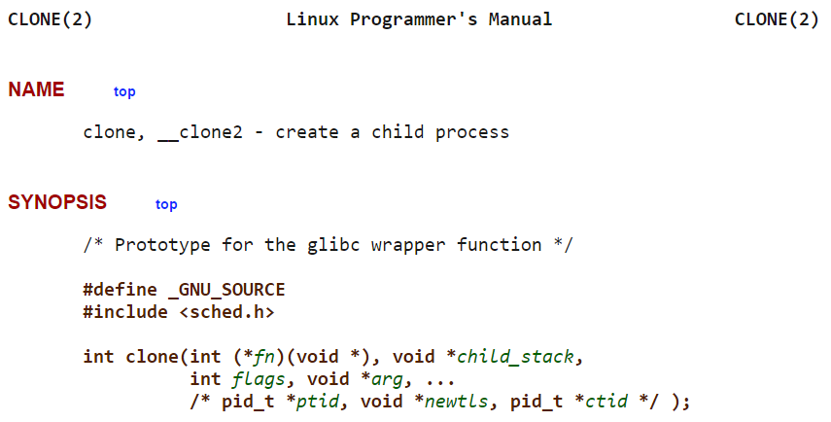
clone()
Allows the child process to share parts of its execution context with the calling process, such as the memory space (page tables), the table of file descriptors, and the table of signal handlers

Slide 18
vfork()
Similar to clone() except that the parent will block until the child exits or performs execve()
execve() loads a new executable and rewrites the memory space
implemented as a clone() system call whose parameter specifies
a SIGCHLD signal
CLONE_VM and CLONE_VFORK flags
child_stack is the current parent stack pointer

Slide 19
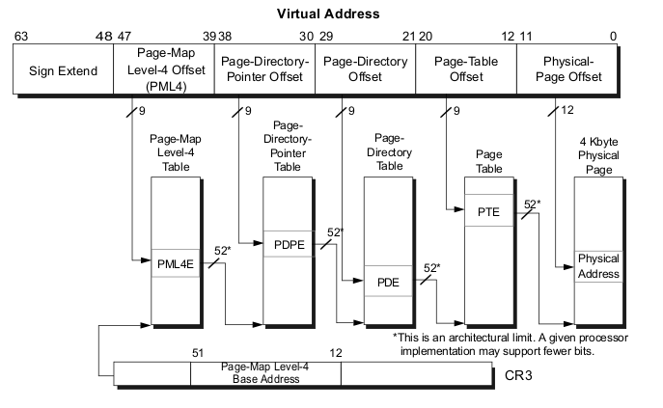
Process switching
Done in Linux schedule() function
Switch the Page Global Directory to install a new address space
Switch the Kernel Mode stack and the hardware context using the switch_to macro
Page Global Directory

Slide 20
Keeping time
A digression

Slide 21
Timer hardware on x86
Real-time clock (RTC)
Use for keeping date
Power by a coin battery
Time-stamp counter (TSC)
rdtsc
Programmable Interval Timer (PIT)
Global timer interrupt at IRQ 0
CPU Local Timer
Raise local interrupt to the CPU the local APIC is attached to
High Performance Event Timer (HPET)
Chip co-developed by Intel and Microsoft
8 32- or 64-bit independent counters driven by each its own (at least) 10MHz clock
ACPI Power Management Timer (ACPI PMT)
3.58MHz

Slide 22
Keeping time
Updates the time elapsed since system startup
Updates the time and date
Determines, for every CPU, how long the current process has been running, and preempts it if it has exceeded the time allocated to it
A time slot is called a quantum; default = 10ms
Updates resource usage statistics
Checks whether the interval of time associated with each software timer has expired

Slide 23
Linux timekeeping architecture
Uniprocessor: all time-keeping activities are triggered by interrupts raised by the global timer
Either the PIT or the HPET
Multiprocessor:
General activities triggered by the interrupts raised by the global timer
CPU-specific activities (such as monitoring the execution time of the currently running process) are triggered by the interrupts raised by the local APIC timer

Slide 24
Important time variables
jiffies: a counter that stores the number of elapsed ticks since the system was started.
It is increased by one when a timer interrupt at 1ms
In x86, jiffies is a 32-bit variable, therefore it wraps around in approximately 50 days
In x86-64, it is a 64 bit variable.
xtime: stores the current time and date;

Slide 25
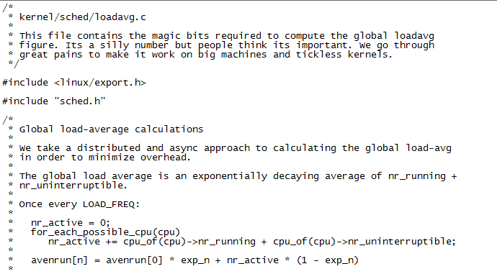
CPU load
3 values: moving average over 1, 5, and 15 minutes

Slide 26
Process Scheduling
Source:
Silberschatz, Galvin and Gagne
Operating System Concepts – 8th Edition
2009

Slide 27
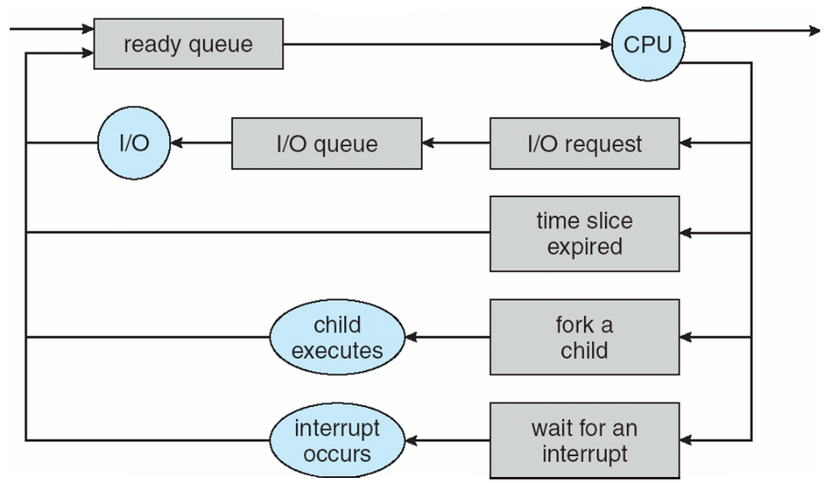
CPU Scheduling
How is the OS to decide which of several tasks to take off a queue?
Scheduling: deciding which threads are given access to resources from moment to moment.

Slide 28
Assumptions about Scheduling
CPU scheduling big area of research in early ‘70s
Many implicit assumptions for CPU scheduling:
One program per user
One thread per program
Programs are independent
These are unrealistic but simplify the problem
Does “fair” mean fairness among users or programs?
If I run one compilation job and you run five, do you get five times as much CPU?
Often times, yes!
Goal: dole out CPU time to optimize some desired parameters of the system.
What parameters?

Slide 29
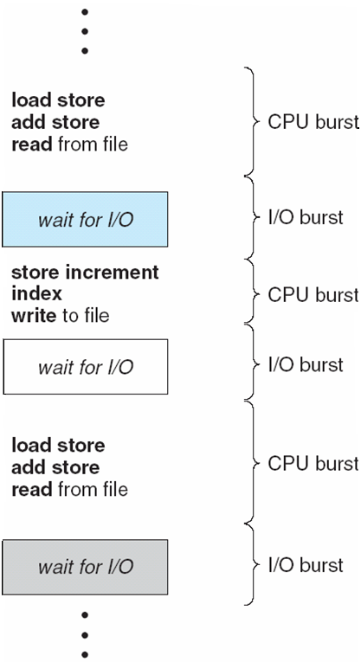
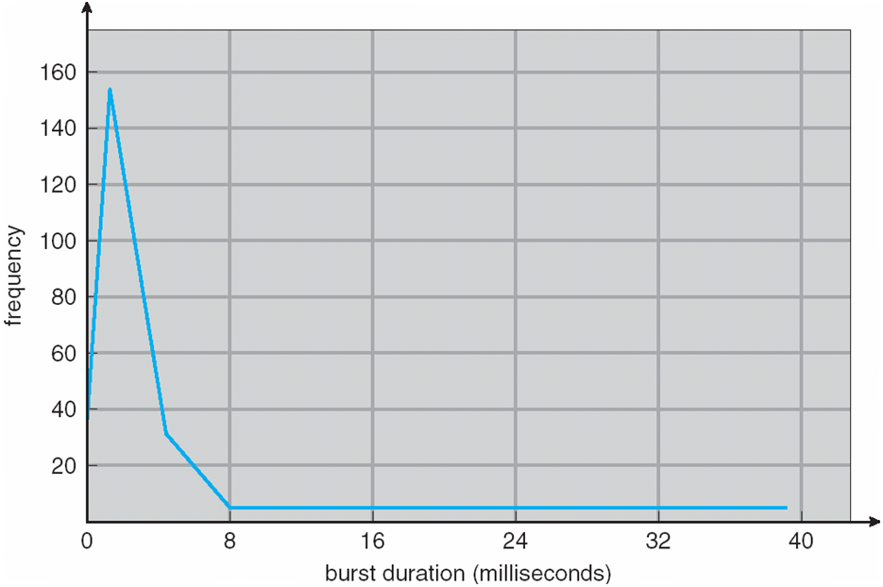
Assumption: CPU Bursts

Slide 30

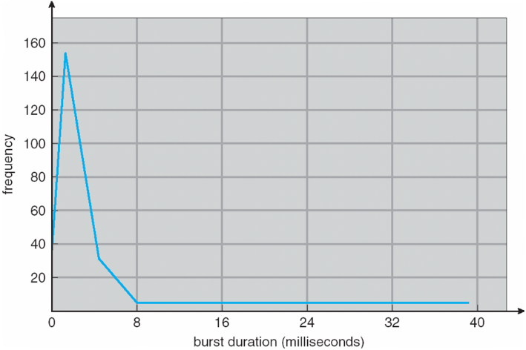
Assumption: CPU Bursts
Execution model: programs alternate between bursts of CPU and I/O
Program typically uses the CPU for some period of time, then does I/O, then uses CPU again
Each scheduling decision is about which job to give to the CPU for use by its next CPU burst
With timeslicing, thread may be forced to give up CPU before finishing current CPU burst.

Slide 31
What is Important in a Scheduling Algorithm?
Turnaround time is the amount of time elapsed from the time of submission to the time of completion.
Response time is the average time elapsed from submission until the first response is produced.
Minimize Response Time
Elapsed time to do an operation (job)
Response time is what the user sees
Time to echo keystroke in editor
Time to compile a program
Real-time Tasks: Must meet deadlines imposed by World
Maximize Throughput
Jobs per second
Throughput related to response time, but not identical
Minimizing response time will lead to more context switching than if you maximized only throughput
Minimize overhead (context switch time) as well as efficient use of resources (CPU, disk, memory, etc.)
Fairness
Share CPU among users in some equitable way
Not just minimizing average response time

Slide 32
Scheduling Algorithms: First-Come, First-Served (FCFS)
“Run until Done:” FIFO algorithm
In the beginning, this meant one program runs non-pre-emtively until it is finished (including any blocking for I/O operations)
Now, FCFS means that a process keeps the CPU until one or more threads block
Example: Three processes arrive in order P1, P2, P3.
P1 burst time: 24
P2 burst time: 3
P3 burst time: 3

Slide 33
Scheduling Algorithms: First-Come, First-Served (FCFS)
Example: Three processes arrive in order P1, P2, P3.
P1 burst time: 24
P2 burst time: 3
P3 burst time: 3
Waiting Time
P1: 0
P2: 24
P3: 27
Completion Time:
P1: 24
P2: 27
P3: 30
Average Waiting Time: (0+24+27)/3 = 17
Average Completion Time: (24+27+30)/3 = 27
P1
P2
P3
0
24
27
30

Slide 34
Scheduling Algorithms: First-Come, First-Served (FCFS)
What if their order had been P2, P3, P1?
P1 burst time: 24
P2 burst time: 3
P3 burst time: 3
Waiting Time
P1: 0
P2: 3
P3: 6
Completion Time:
P1: 3
P2: 6
P3: 30
Average Waiting Time: (0+3+6)/3 = 3 (compared to 17)
Average Completion Time: (3+6+30)/3 = 13 (compared to 27)
P2
P3
P1
0
3
6
30

Slide 35
Scheduling Algorithms: First-Come, First-Served (FCFS)
Average Waiting Time: (0+3+6)/3 = 3 (compared to 17)
Average Completion Time: (3+6+30)/3 = 13 (compared to 27)
FIFO Pros and Cons:
Simple (+)
Short jobs get stuck behind long ones (-)
If all you’re buying is milk, doesn’t it always seem like you are stuck behind a cart full of many items
Performance is highly dependent on the order in which jobs arrive (-)

Slide 36
Round Robin (RR) Scheduling
FCFS Scheme: Potentially bad for short jobs!
Depends on submit order
If you are first in line at the supermarket with milk, you don’t care who is behind you; on the other hand…
Round Robin Scheme
Each process gets a small unit of CPU time (time quantum)
Usually 10-100 ms
After quantum expires, the process is preempted and added to the end of the ready queue
Suppose N processes in ready queue and time quantum is Q ms:
Each process gets 1/N of the CPU time
In chunks of at most Q ms
What is the maximum wait time for each process?
No process waits more than (n-1)q time units

Slide 37
Round Robin (RR) Scheduling
Round Robin Scheme
Each process gets a small unit of CPU time (time quantum)
Usually 10-100 ms
After quantum expires, the process is preempted and added to the end of the ready queue
Suppose N processes in ready queue and time quantum is Q ms:
Each process gets 1/N of the CPU time
In chunks of at most Q ms
What is the maximum wait time for each process?
No process waits more than (n-1)q time units
Performance Depends on Size of Q
Small Q => interleaved
Large Q is like FCFS
Q must be large with respect to context switch time, otherwise overhead is too high (spending most of your time context switching!)

Slide 38
Example of RR with Time Quantum = 4
Process Burst Time
P₁ 24
P₂ 3
P₃ 3
The Gantt chart is:
P₁
P₂
P₃
P₁
P₁
P₁
P₁
P₁
0
4
7
10
14
18
22
26
30

Slide 39
Example of RR with Time Quantum = 4
Process Burst Time
P₁ 24
P₂ 3
P₃ 3
Waiting Time:
P1: (10-4) = 6
P2: (4-0) = 4
P3: (7-0) = 7
Completion Time:
P1: 30
P2: 7
P3: 10
Average Waiting Time: (6 + 4 + 7)/3= 5.67
Average Completion Time: (30+7+10)/3=15.67
P₁
P₂
P₃
P₁
P₁
P₁
P₁
P₁
0
4
7
10
14
18
22
26
30

Slide 40
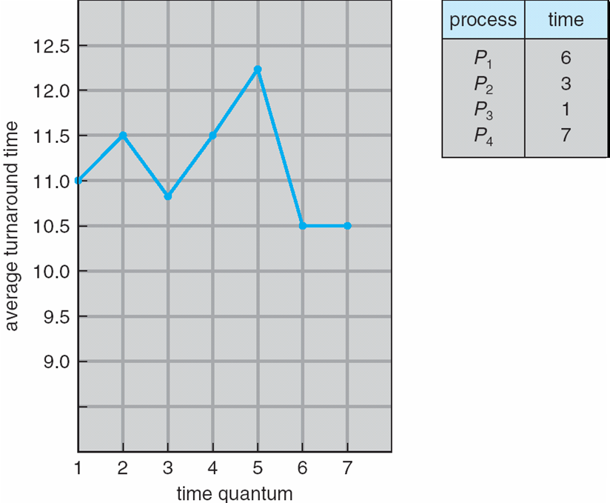
Turnaround Time Varies With The Time Quantum

Slide 41
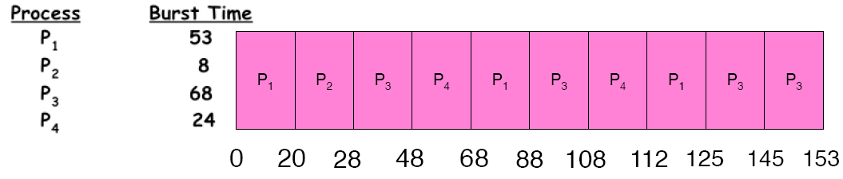
Example of RR with Time Quantum = 20
Waiting Time:
P1: (68-20)+(112-88) = 72
P2: (20-0) = 20
P3: (28-0)+(88-48)+(125-108) = 85
P4: (48-0)+(108-68) = 88
Completion Time:
P1: 125
P2: 28
P3: 153
P4: 112
Average Waiting Time: (72+20+85+88)/4 = 66.25
Average Completion Time: (125+28+153+112)/4 = 104.5
A process can finish before the time quantum expires, and release the CPU.

Slide 42
RR Summary
Pros and Cons:
Better for short jobs (+)
Fair (+)
Context-switching time adds up for long jobs (-)
The previous examples assumed no additional time was needed for context switching – in reality, this would add to wait and completion time without actually progressing a process towards completion.
Remember: the OS consumes resources, too!
If the chosen quantum is
too large, response time suffers
infinite, performance is the same as FIFO
too small, throughput suffers and percentage overhead grows
Actual choices of timeslice:
UNIX: initially 1 second:
Worked when only 1-2 users
If there were 3 compilations going on, it took 3 seconds to echo each keystroke!
In practice, need to balance short-job performance and long-job throughput:
Typical timeslice 10ms-100ms
Typical context-switch overhead 0.1ms – 1ms (about 1%)

Slide 43
Comparing FCFS and RR
Job # | FCFS CT | RR CT
1 | 100 | 991
2 | 200 | 992
… | … | …
9 | 900 | 999
10 | 1000 | 1000
Assuming zero-cost context switching time, is RR always better than FCFS?
Assume 10 jobs, all start at the same time, and each require 100 seconds of CPU time
RR scheduler quantum of 1 second
Completion Times (CT)
Both FCFS and RR finish at the same time
But average response time is much worse under RR!
Bad when all jobs are same length
Also: cache state must be shared between all jobs with RR but can be devoted to each job with FIFO
Total time for RR longer even for zero-cost context switch!

Slide 44
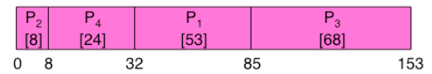
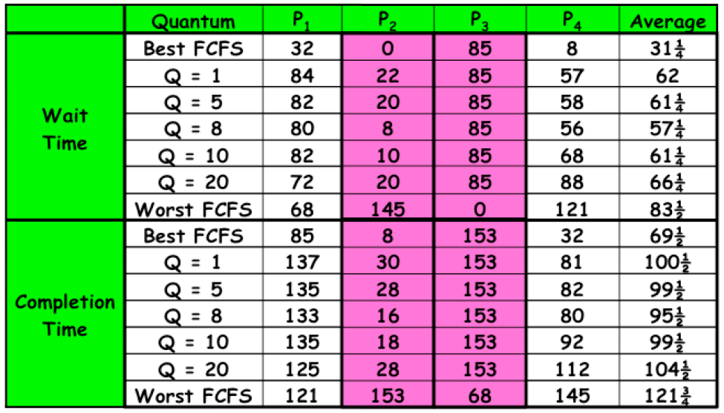
Comparing FCFS and RR

Slide 45
Scheduling
The performance we get is somewhat dependent on what “kind” of jobs we are running (short jobs, long jobs, etc.)
If we could “see the future,” we could mirror best FCFS
Shortest Job First (SJF) a.k.a. Shortest Time to Completion First (STCF):
Run whatever job has the least amount of computation to do
Shortest Remaining Time First (SRTF) a.k.a. Shortest Remaining Time to Completion First (SRTCF):
Preemptive version of SJF: if a job arrives and has a shorter time to completion than the remaining time on the current job, immediately preempt CPU
These can be applied either to a whole program or the current CPU burst of each program
Idea: get short jobs out of the system
Big effect on short jobs, only small effect on long ones
Result: better average response time

Slide 46
Scheduling
But, time to completion, remaining time, burst time etc. are hard to estimate
We could get feedback from the program or the user, but they have incentive to lie!
SJF/SRTF are the best you can do at minimizing average response time
Provably optimal (SJF among non-preemptive, SRTF among preemptive)
Since SRTF is always at least as good as SJF, focus on SRTF
Comparison of SRTF with FCFS and RR
What if all jobs are the same length?
SRTF becomes the same as FCFS (i.e. FCFS is the best we can do)
What if all jobs have varying length?
SRTF (and RR): short jobs are not stuck behind long ones

Slide 47
Example: SRTF
A,B: both CPU bound, run for a week
C: I/O bound, loop 1ms CPU, 9ms disk I/O
If only one at a time, C uses 90% of the disk, A or B could use 100% of the CPU
With FIFO: Once A and B get in, the CPU is held for two weeks
What about RR or SRTF?
Easier to see with a timeline
A or B
C
C I/O

Slide 48
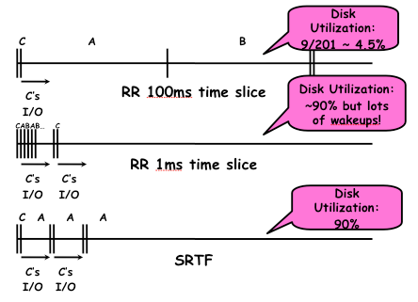
Example: SRTF
A or B
C
C I/O
A,B: both CPU bound, run for a week
C: I/O bound, loop 1ms CPU, 9ms disk I/O

Slide 49
SRTF summary
Starvation
SRTF can lead to starvation if many small jobs!
Large jobs never get to run
Somehow need to predict future
How can we do this?
Some systems ask the user
When you submit a job, you have to say how long it will take
To stop cheating, system kills job if it takes too long
But even non-malicious users have trouble predicting runtime of their jobs
Bottom line, can’t really tell how long job will take
However, can use SRTF as a yardstick for measuring other policies, since it is optimal
SRTF Pros and Cons
Optimal (average response time) (+)
Hard to predict future (-)
Unfair, even though we minimized average response time! (-)

Slide 50
Predicting the Future
Back to predicting the future… perhaps we can predict the next CPU burst length?
Iff programs are generally repetitive, then they may be predictable
Create an adaptive policy that changes based on past behavior
CPU scheduling, virtual memory, file systems, etc.
If program was I/O bound in the past, likely in the future
Example: SRTF with estimated burst length
Use an estimator function on previous bursts
Let T(n-1), T(n-2), T(n-3), …, be previous burst lengths. Estimate next burst T(n) = f(T(n-1), T(n-2), T(n-3),…)
Function f can be one of many different time series estimation schemes

Slide 51
Determining Length of Next CPU Burst
Can only estimate the length
Can be done by using the length of previous CPU bursts, using exponential averaging

Slide 52
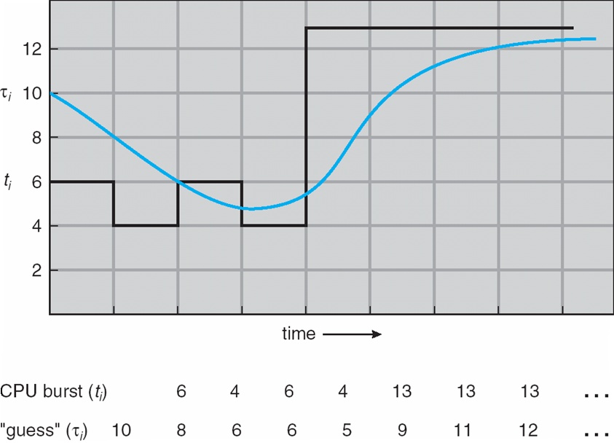
Predicting the Future

Slide 53
Priority Scheduling
A priority number (integer) is associated with each process
The CPU is allocated to the process with the highest priority (smallest integer ≡ highest priority)
Preemptive (if a higher priority process enters, it receives the CPU immediately)
Nonpreemptive (higher priority processes must wait until the current process finishes; then, the highest priority ready process is selected)
SJF is a priority scheduling where priority is the predicted next CPU burst time
Problem ≡ Starvation – low priority processes may never execute
Solution ≡ Aging – as time progresses increase the priority of the process
Example: Windows gives foreground processes higher priority than background ones

Slide 54
Linux niceness
Base priority of processes is known as niceness in Linux
Value is between -20 (most favorable for scheduling) to 19 (least favorable)
User can change niceness value within certain limits
Superseded by getpriority() and setpriority() calls
Range is kernel version dependent

Slide 55
Priority Inversion Example
Three processes: one with high priority (H), one with medium priority (M), and one with low priority (L)
Process L is running and successfully acquires a lock
Process H kicks in and preempts process L
Process H tries to acquire L’s lock, and blocks (because it is held by L)
Process M begins running, and, since it has a higher priority than L, it is the highest priority ready process. It preempts L and runs, thus starving high priority process H.
This is known as priority inversion

Slide 56
Fixing Priority Inversion
Fix: Process L temporarily granted the high priority of process H
Priority inheritance
This enables process L to preempt process M and run.
When process L is finished, process H becomes unblocked.
Process H, now being the highest priority ready process, runs, and process M must wait until it is finished.
Note that if process M’s priority is actually higher than process H, process L having H’s priority is insufficient to preempt M.
This is expected behavior

Slide 57
Multi-level Feedback Scheduling
Another method for exploiting past behavior
Multiple queues, each with different priority
Higher priority queues often considered “foreground” tasks
Each queue has its own scheduling algorithm
E.g. foreground → RR, background → FCFS
Sometimes multiple RR priorities with quantum increasing exponentially (highest queue: 1ms, next: 2ms, next: 4ms, etc.)
Adjust each job’s priority as follows (details vary)
Job starts in highest priority queue
If entire CPU time quantum expires, drop one level
If CPU is yielded during the quantum, push up one level (or to top)

Slide 58
Scheduling Details
Result approximates SRTF
CPU bound jobs drop rapidly to lower queues
Short-running I/O bound jobs stay near the top
Scheduling must be done between the queues
Fixed priority scheduling: serve all from the highest priority, then the next priority, etc.
Time slice: each queue gets a certain amount of CPU time (e.g., 70% to the highest, 20% next, 10% lowest)
Countermeasure: user action that can foil intent of the OS designer
For multilevel feedback, put in a bunch of meaningless I/O to keep job’s priority high
But if everyone does this, it won’t work!

Slide 59
Scheduling Details
It is apparent that scheduling is facilitated by having a “good mix” of I/O bound and CPU bound programs, so that there are long and short CPU bursts to prioritize around.
There is typically a long-term and a short-term scheduler in the OS.
We have been discussing the design of the short-term scheduler.
The long-term scheduler decides what processes should be put into the ready queue in the first place for the short-term scheduler, so that the short-term scheduler can make fast decisions on a good mix of a subset of ready processes.
The rest are held in memory or disk
This also provides more free memory for the subset of ready processes given to the short-term scheduler.

Slide 60
Fairness
What about fairness?
Strict fixed-policy scheduling between queues is unfair (run highest, then next, etc.)
Long running jobs may never get the CPU
In Multics, admins shut down the machine and found a 10-year-old job
Must give long-running jobs a fraction of the CPU even when there are shorter jobs to run
Tradeoff: fairness gained by hurting average response time!
How to implement fairness?
Could give each queue some fraction of the CPU
i.e., for one long-running job and 100 short-running ones?
Like express lanes in a supermarket – sometimes express lanes get so long, one gets better service by going into one of the regular lines
Could increase priority of jobs that don’t get service (as seen in the multilevel feedback example)
This was done in UNIX
Ad hoc – with what rate should priorities be increased?
As system gets overloaded, no job gets CPU time, so everyone increases in priority
Interactive processes suffer

Slide 61
Lottery Scheduling
Yet another alternative: Lottery Scheduling
Give each job some number of lottery tickets
On each time slice, randomly pick a winning ticket
On average, CPU time is proportional to number of tickets given to each job over time
How to assign tickets?
To approximate SRTF, short-running jobs get more, long running jobs get fewer
To avoid starvation, every job gets at least one ticket (everyone makes progress)
Advantage over strict priority scheduling: behaves gracefully as load changes
Adding or deleting a job affects all jobs proportionally, independent of how many tickets each job possesses

Slide 62
Process Scheduling in Linux

Slide 63
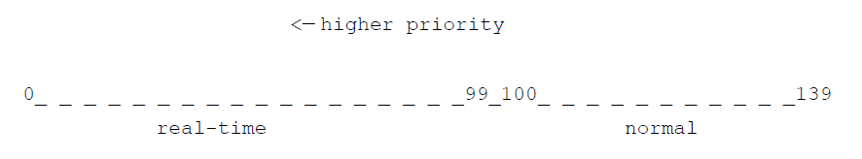
Type of Processes
Normal processes
Priorities are dynamic
Real-time processes
Standard Linux does not have hard realtime processes
Two scheduling policies: FIFO or round-robin
Static priorities
Dictated by POSIX standard
Priority scale used inside the Linux kernel

Slide 64
Miscellaneous issues
The main entry of the scheduler is schedule()
Called in many places when a CPU control is to be relinquished
There is one or more runqueues for tasks per CPU
Exact configuration depends on the scheduler used
Since version 2.6, the kernel itself is preemptible
Except when local interrupts (timer) are disabled
Structure of kernel spinlocks had to be changed
Each task has a processor affinity mask which tells which CPU the task can run on

Slide 65
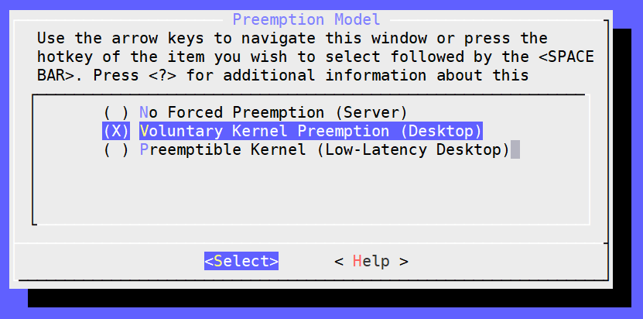
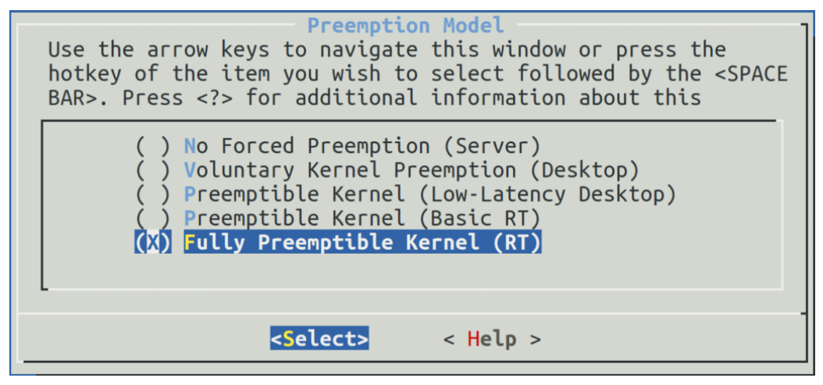
Preemption options
Standard default:
Real-time patch applied:

Slide 66
schedule()
Defined in kernel/sched/core.c
Goal: replace currently executing task with another one
Either:
Called explicitly in many places where CPU is to be relinquished or
in a lazy way by activating the “need scheduling” flag that the kernel often checks
May not always switch task
No other task in the runqueue
No task of higher priority
Timeslice (quantum) not expired

Slide 67
scheduler_tick()
The timer interrupt is used for scheduling
On a timer interrupt, update_process_times() is called.
It in turns calls scheduler_tick()
Triggers preemption if necessary

Slide 68
Scheduling Realtime Processes in Linux

Slide 69
The realtime scheduler
Code in kernel/sched/rt.c
A real-time task inhibits the execution of every lower-priority task while it remains runnable
A real-time task is replaced by another task only when:
The task is preempted by another task of higher real-time priority
The task performs a blocking operation, and it is put to sleep.
The task is stopped, or it is killed.
The task voluntarily relinquishes the CPU
The task is SCHED_RR and it has exhausted its time quantum.

Slide 70
Linux real-time scheduling policies
SCHED_FIFO
No time slicing
Can be used only with static priorities higher than 0
“Low class” citizen, easily preempted
The preempted FIFO task will stay at the head of the list for its priority and will resume execution as soon as all tasks of higher priority are blocked again.
When a blocked SCHED_FIFO task becomes runnable, it will be inserted at the end of the list for its priority.
SCHED_RR
Given a time quantum, pre-empted when it runs out
Preempted task will be put at the end of the list for its priority.

Slide 71
Scheduling Normal Processes in Linux

Slide 72
The early scheduling algorithm
First scheduler introduced in kernel version 0.01 in 1991
Only one task queue
Code scans entire queue to look for next task to schedule
Not scalable
Implements preemptive multitasking

Slide 73
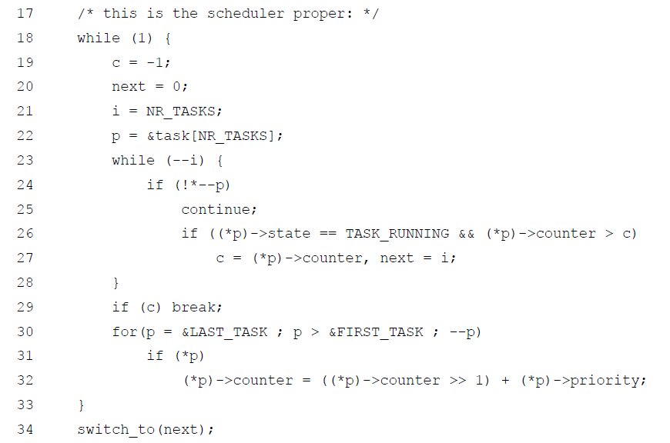
Linux kernel 0.01 Scheduler

Slide 74
O(n) Scheduler
Used in kernel version 2.4
Similar to the version 0.01 in idea
Time is divided up into epoch
Every task can execute up to its timeslice in the current epoch
Half of the unused time in the current epoch is added to the next epoch
Each task has a goodness factor
Goodness is a function of the remaining time and the priority of the task
Runqueue is scanned and the “most good” task is chosen to run next

Slide 75
O(n) Scheduler
Advantage: Simple
Disadvantage: Cannot scale

Slide 76

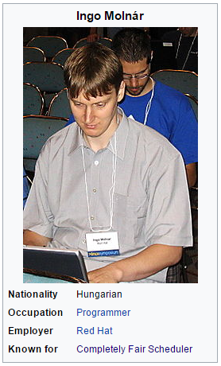

Current state: The duel of two hackers
vs

Slide 77
O(1) Scheduler
Ingo Molnár introduced a constant time task scheduler in 2.6 kernel
Global priority scale, from 0 to 139
lower value, higher priority
real-time task: 0 to 99 and normal task: 100 to 139
Higher priority tasks got larger timeslices – important tasks would run longer
Early preemption: when a task entered TASK_RUNNING state, the kernel checks whether its priority was higher than the one of currently running task’s, and if it was, the scheduler was invoked to grant CPU to the newly runnable task;
Static priority for real-time tasks;
Dynamic priority for normal tasks, depending on their interactivity.
A task’s priority was recalculated when it finished its timeslice.
According to its behavior in the past, level of interactivity was determined.
Interactive tasks were preferred by the scheduler.

Slide 78
Compared to before
Previous schedulers explicitly recalculating each task’s priority at the end of an epoch
The tasks were kept in one runqueue (linked list or array)
A loop over all the existing tasks on the system was run through every time a switch was in place
O(1) scheduler instead maintains two priority arrays: active and expired per CPU runqueue

Slide 79
The two priority arrays
Active array: all the tasks in the associated runqueue that had timeslice left
Expired array: all the tasks that had exhausted their timeslice
Every time a task exhausted its timeslice, it is moved from active to expired, and a priority recalculation is made
When active array is empty, swap the two arrays

Slide 80
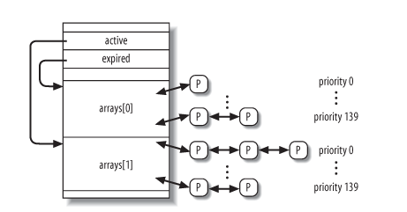
Storage layout of the two arrays
Each priority array consists of
140 doubly linked list heads (one list for each priority value)
a priority bitmap
number of tasks in the set.

Slide 81
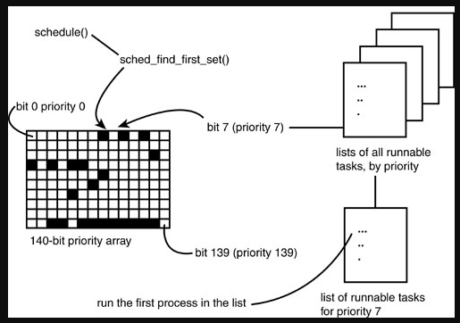
The priority bitmap
One bit for each priority level
Bit position ordered by priority level
If bit is set, that priority level has at least one task in it
For easy finding of whether a particular priority level is empty or not
Updated when a new task is inserted into the priority array

Slide 82
Major flaw of O(1) scheduler
“Interactive-ness” very difficult to say for sure
But it is important to give interactive tasks higher priority
Tried to identify interactive tasks by analyzing the average sleep time (waiting for input) and the scheduler gave a priority bonus to such tasks for better throughput and user experience.

Slide 83
Staircase Scheduler
Introduced by Con Kolivas in 2004
Runqueue is a ranked array of tasks (for each CPU)
Initially all tasks sorted by priority in the runqueue
The difference: no expired list
If task P with priority x exhaust its timeslice of t, its priority becomes (x-1) (smaller is lower priority) and P is inserted into the runqueue
When P reaches lowest priority (say L) and exhaust its timeslice (“falling off the stairs”), it is given priority (L+1) and a timeslice of 2t, and reinserted into the runqueue
If it happens again, priority increased to (L+2) timeslice increased to 3t and so on

Slide 84
Rationale of the Staircase Scheduler
Interactive tasks sleep a lot (waiting for I/O) and don’t exhaust their timeslice as frequently as batch jobs
Batch jobs sink to the lower priorities but “earns” bigger timeslices
Gradually given more CPU time to finish up
Interactive jobs tend to stay at the top

Slide 85
The Rotating Staircase Scheduler
Released by Con Kolivas in 2007
Reintroduced the expired array and the concept of an epoch
Each task has a quota:
RR_INTERVAL (6ms) for those between niceness 0 and 19
Progressively higher for those between niceness -1 to -20
Each runqueue (one per CPU) has an array of quota for each priority
Each time we deduct the quota of a task, we also do so for its priority level’s quota

Slide 86
Basic idea
Select task from the front of the highest priority level queue to run next – O(1) using the bitmap trick
Check when a task is enqueued at a particular priority level:
If first time for current epoch, timeslice is assigned the fixed quota value. Same value added to runqueue’s quota for this priority.
If not (1), but neither timeslice for the task nor the total quota for this priority exhausted, task simply enqueued
If not (2), task lowered to next priority level, repeat (1) at the new level
If cannot do (3), task move to expired list at its original priority

Slide 87
Rotations (epoch)
Minor rotation: When a quota for a priority level is exhausted, any remaining tasks at the current priority level is forced to be lowered to the next level of priority
Major rotation: When all the quotas in the active array are exhausted, swap active and expired arrays
Time between major rotation is defined as an ‘epoch’

Slide 88
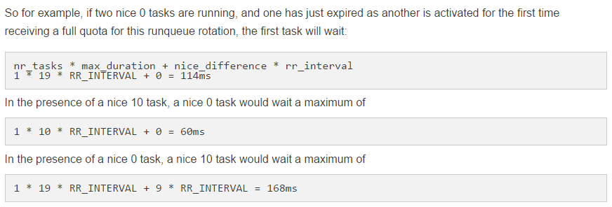
Deadline
Unlike previous schedulers, no dependence on sleep duration
Duration of a epoch (time between major rotation) can be predicted
Niceness is between -20 (most favorable for scheduling) to 19 (least favorable)

Slide 89
Favoring interactivity
Interactive jobs sleep for a long time
Note: When asleep, such task do not appear in the runqueue
Unlikely to wake up in the same epoch
They may have used some of the timeslice in another epoch, but when they wake up in the current epoch, they get the full quota
They also less likely to get priority demotion

Slide 90
Completely Fair Scheduling

Slide 91
Completely Fair Scheduler
None of Con Kolivas code accepted in main branch
Ingo Molnar came up with the completely fair scheduler (CFS)
Standard scheduler in Linux since kernel version 2.6.23
CFS basically models an “ideal, precise multitasking CPU” on real hardware.
With n running tasks, each task would be having 1/n amount of CPU-time while running constantly
Based on the idea of weighted fair queuing in network scheduling

Slide 92
Ideal Fair Scheduling
If there are N processes, each should get 1/N of the CPU time
If at time x, 1 process finishes, then the remaining N-1 processes should get the 1/(N-1) for the rest of the time
What about priority?
Weighted fairness

Slide 93
Approximating fairness
No single, fixed timeslice: the scheduler calculates how long a task should run as a function of the total number of currently runnable tasks
The situation is dynamic
Need a lower bound to prevent thrashing as the number of tasks scales
Priority should be considered.
Two challenges:
How to be fair?
How to be efficient (least overhead)?

Slide 94
Time-ordered Red-black Tree
Instead of lists and arrays, CFS uses a red-black tree as its central data structure
Node is indexed by “virtual time” – a function of how long a task has run
The smaller the key, the more to the left of the tree a node is
The scheduler always picks the leftmost node as the next task to run

Slide 95
Red-black Trees
A digression

Slide 96
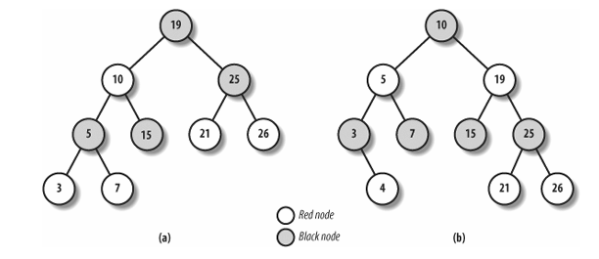
Red-black trees
A variant of binary search tree (BST)
Balance: the path from the root to the farthest leaf is no more than twice as long as the path from the root to the nearest leaf
Every red-black tree with n internal nodes has a height of at most 2 × log(n + 1)

Slide 97
Properties of Red-Black Trees
Property 1: Every node must be either red or black
Property 2: The root of the tree must be black
Property 3: All leaves (“nodes” containing NIL/NULL) is black
Property 4: If a node is red, then both its children are black
Property 5: Every path from a node to a descendant leaf must contain the same number of black nodes (black depth)

Slide 98
Operations on RB Trees
All operations can be performed in O(log n) time.
The query operations, which don’t modify the tree, are performed in exactly the same way as they are in BSTs.
Insertion and Deletion are not straightforward.
Source: Wikipedia

Slide 99
Query Operation
Relies on the BST property – for a given node X with key k:
all the nodes on its left branch are either null or have keys less than k
all the nodes on its right branch are either null or have keys greater than k
To find a node with a given key is O(log n)

Slide 100
Rotations
Rotations are the basic tree-restructuring operation for almost all balanced search trees.
Rotation takes a red-black-tree and a node,
Changes pointers to change the local structure, and
Won’t violate the binary-search-tree property.
Left rotation and right rotation are inverses.

Slide 101
Rotations
x
Left-Rotate(T, x)
y
α
γ
y
Right-Rotate(T, y)
x
β
γ
α
β

Slide 102
Insert into a Red-Black Tree
Colour the node to be inserted by red initially
Insert just like in a binary search tree
Check for property violation and do one of two things (may need repetition):
Change the a red node to black
Rotation
Terminology: an uncle of a node X is the sibling of the parent of X
Notation: let node inserted be N, its parent P, and its uncle U, and the grandparent (i.e., parent of P) be G

Slide 103
Insertion Case 1
The node inserted, N, is the root
Violates Property 2 (root must be black)
Change colour of N to black
Otherwise, go to Case 2

Slide 104
Insertion Case 2
If the parent of N, i.e., P, is black, then we are done; return
Otherwise proceed to Case 3

Slide 105
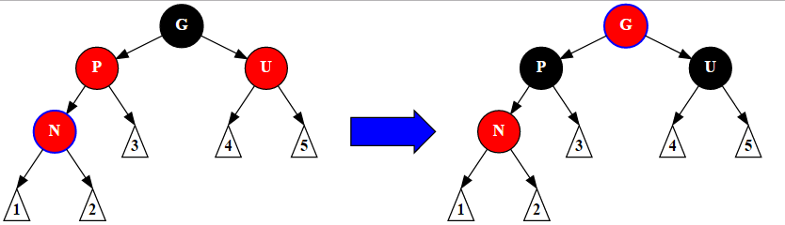
Insertion Case 3
P is red, and U is not null and is red
Change P and U to black and G to red, and go to Case 1
Otherwise, go to Case 4

Slide 106
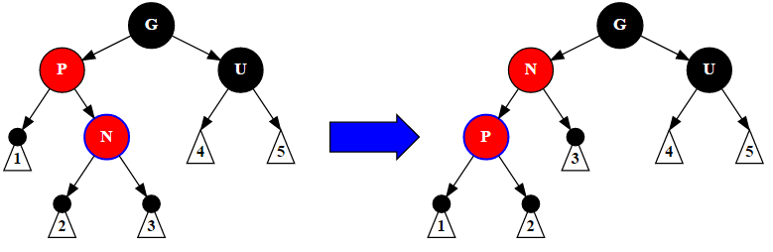
Insertion Case 4
P is red but U is black
If N is the right child of P, and P is the left child of G then remedy is left rotation on P
If N is the left child of P, and P is the right child of G then remedy is right rotation on P
(Must) go to Case 5

Slide 107
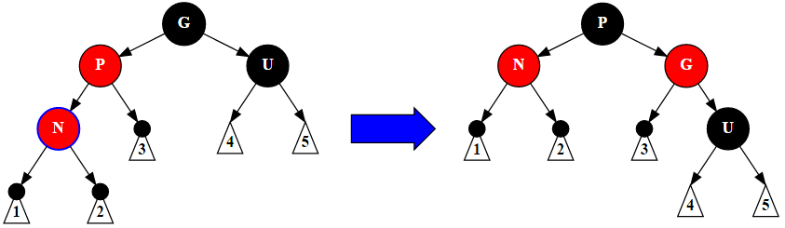
Insert Case 5
P is red but U is black
If N is left child of P, and P is left child of G, then remedy is right rotation on G
Otherwise, rotate left on G
Switch colours of P and G

Slide 108
An Example
1
Empty tree, insert 1

Slide 109
An Example
1
Property 2 violated
Recolour to black!

Slide 110
An Example
1
Property 2 violated
Recolour to black
All properties satisfied

Slide 111
An Example
1
Insert 2
2

Slide 112
An Example
1
All properties satisfied
2

Slide 113
An Example
1
Insert 3
2
3

Slide 114
An Example
1
Property 4 violated
Case 5 – rotate left on grandparent
2
3

Slide 115
An Example
2
Property 4 violated
Case 5 – rotate left on grandparent
1
3

Slide 116
An Example
2
Recolour
1
3

Slide 117
An Example
2
Insert 4
Property 4 violated
1
3
4

Slide 118
An Example
2
Invoke Case 3
1
3
4

Slide 119
An Example
2
Violates Property 2
Recolour!
1
3
4

Slide 120
An Example
2
Black depth is 3
All properties satisfied
1
3
4

Slide 121
An Example
2
Insert 5
1
3
4
5

Slide 122
An Example
2
Invoke Case 5
Left rotate on grandparent 3
And switch colour
1
3
4
5

Slide 123
An Example
2
All properties satisfied
1
4
3
5

Slide 124
An Example
2
Insert 6
1
4
3
5
6

Slide 125
An Example
2
Invoke Case 3 - recolour
1
4
3
5
6

Slide 126
An Example
2
All properties satisfied
1
4
3
5
6

Slide 127
Deletion Operation in a Red-Black Tree
Deletion is tedious involving recursion and more cases to check
Can trigger rebalancing in other parts of the tree
We shall skip this
If you are interested, many tutorials and description available online
Now back to our Completely Fair Scheduler…

Slide 128
Back to CFS
CFS uses a red-black tree of runnable tasks with vruntime as the key
CFS picks the task with the smallest vruntime is the next task to run
It is always the leftmost non-null node of the red-black tree
This node is “cached” – pointed to by a special pointer; no need to do the O(log n) traversal to find

Slide 129
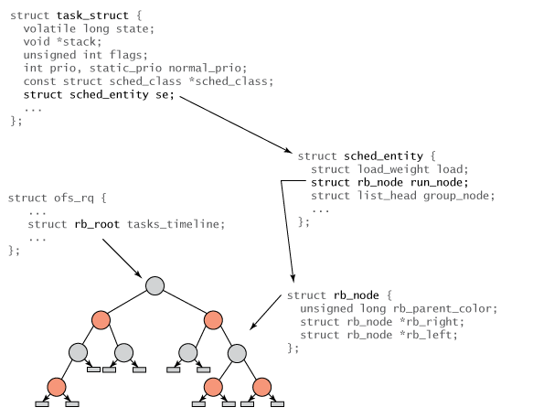
CFS Data Structure

Slide 130
Virtual Clock and vruntime
A measure of the amount of time a waiting task would have been allowed to run on a completely fair processor
Calculated using actual time and a task’s load weight
Uses high precision timer and timer interrupts
Priority implicitly accounted for
No per priority runqueue
There is a minimum to prevent thrashing when the runqueue is very large

Slide 131
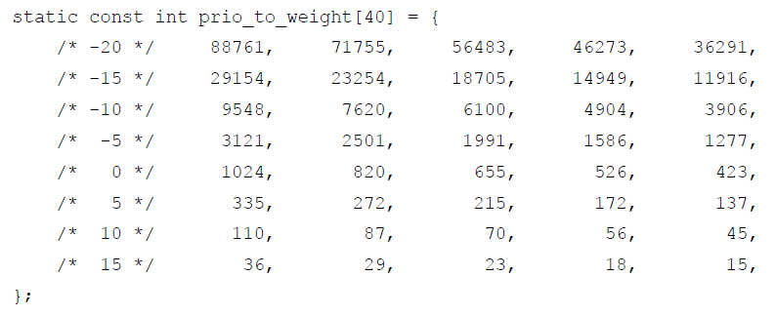
Load weight
The relation between niceness and timeslices of tasks is maintained by calculating load weights
Two tasks, running by default at nice level 0 – weight 1024. Each of these tasks receives 50% of CPU time, because 1024/(1024+1024) = 0.5
If one task now becomes nice -1, it should get around 10% CPU time more, and the other 10% less: 1277/(1024+1277) ≈ 0.55; 1024/(1024+1277) ≈ 0.45
≈ 1024 x (1.25)^{-nice}

Slide 132
The “10% effect”
From any nice level,
Go up 1 level (priority lowered by 1): -10% CPU usage
Go down 1 level (priority raised by 1): +10% CPU usage
Is relative and cumulative

Slide 133
Concept of a “period”
Time is divided into periods.
A period is a length of time in which every task ran at least once.
if #runnable tasks > some threshold (default 8)
period = #runnable task * min_granularity (default 0.75ms)
else
period = base (default 6ms)
The time slice given to each task is weighted by its weight
Time slice for a task = period * (weight of task) / (total weight of runqueue)

Slide 134
Time slices
If there are many tasks, a low level task may get 0 time!
Guarantee: all tasks will get at least 0.75ms (sched_min_granularity) to run
Period will be lengthened appropriately to ensure this when necessary
Number of runnable tasks may change
Period recomputed at every time slice computation
Time slice is computed only when a task is picked for execution next

Slide 135
How CFS works
When the scheduler is called, the current task’ vruntime is updated
Actual time the task ran for weighted as follows:
vruntime += (time process ran) * (load weight niceness 0 ) / (load weight of this process)
Or in other words:
vruntime += (time process ran) * 1024 / (load weight of this process)
Overall virtual time tick is maintained in min_vruntime for the entire runqueue
The kernel takes vruntime of the leftmost element in the tree, if it exists, or that of a currently running task, depending on which is smaller.
Next task is the leftmost node in the red-black tree, i.e., the one with the lowest vruntime, i.e., min_vruntime
Note: because they wanted to avoid division as well as extend the arithmetic to 64 bit, the actual code in kernel/sched/fair.c contains some arithmetic voodoo.

Slide 136
How CFS works
For new tasks, vruntime = min_vruntime
For newly woken tasks
Before sleeping, compute and store delta between vruntime and current min_vruntime
After waking, recompute vruntime by adding delta to current min_vruntime
Prevents a task that had slept for a long time from hogging the processor

Slide 137
vruntime and nice value
Nice value = 0: vruntime = real time spent by task
Nice < 0: vruntime < real time spent by task and vruntime grows slower than real time
Nice > 0: vruntime > real time spent by task and vruntime grows faster than real time

Slide 138
CFS Principles
When a task is executing, its virtual run time increases, so it moves to the right in the red-black tree
Only updated during a schedule() call
A compute intensive job would have run for a long time so it will move to the far right
A I/O intensive job would have ran for a short period so it will move only a little to the right
Virtual clock ticks more slowly for more important tasks

Slide 139
Small digression: floating point and the kernel
There are many more floating point registers than general purpose ones
High overhead in saving
Kernel code not linked against the math library
Hence, use of floating point computation in the kernel is discouraged
Still doable if you insists but with the proper API to save and restore
Use (scaled) integer (a.k.a. fixed point) instead
Example: 6ms is stored as an integer 6000000
Use approximated integer calculation as in the scheduler

Slide 140
CFS Group Scheduling
Starting from kernel version 2.6.24, CFS group scheduling was introduced
Issue: Suppose there are 50 tasks, each would get 2% of CPU. But what if 48 of them are child tasks of a single task? Is it fair?
Previously, a scheduling entity is a task. But in group scheduling, it can be many tasks.
Time pie is divided among scheduling entities – not tasks directly
A.k.a. fair share scheduling
Can be task hierarchy, user group, interactive vs. non-interactive etc.

Slide 141
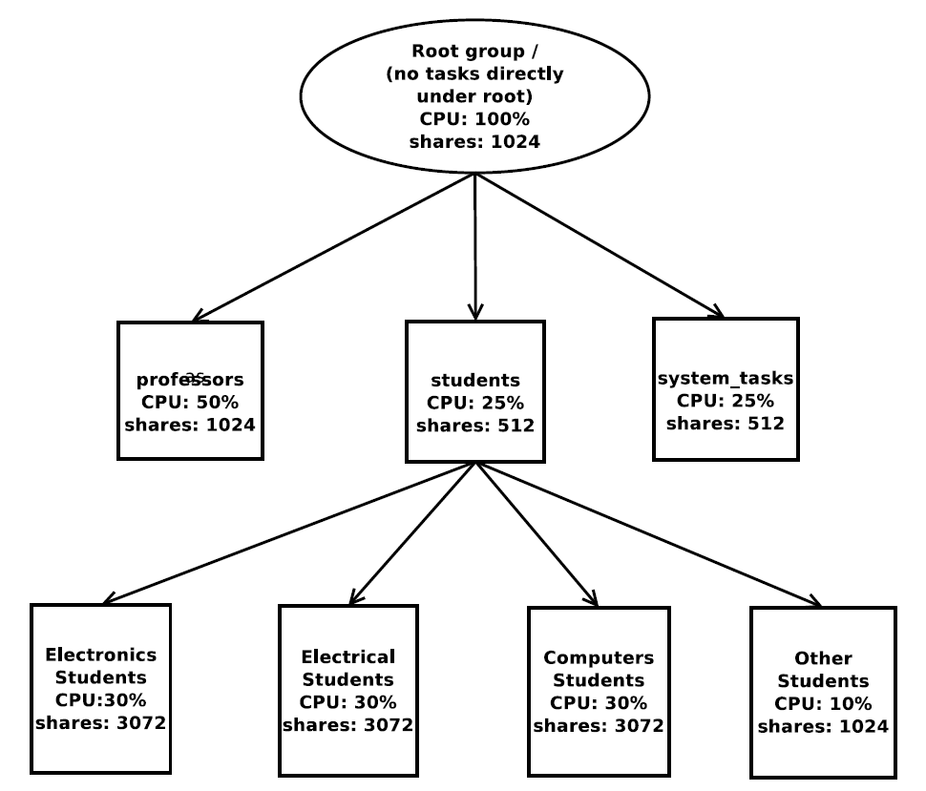
Use of shares

Slide 142
CFS Bandwidth Control
Optional feature of CFS
Allows user to specify a limit to the CPU time given to a group or process hierarchy

Slide 143
SMP Load Balancing
Each CPU has its own runqueue (red-black tree)
To tackle imbalance, tasks are moved from busy runqueues to less busy ones occasionally
Tries to balance out the total weight (load) of the runqueues

Slide 144
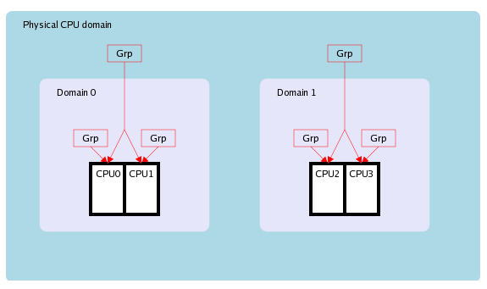
Scheduling Domain
Multi-CPU machines may be NUMA
A CPU may be “closer” to some and “farther” from others
Bad scenario: A cooperating group of tasks is scheduled “all over”
Scheduling domains was introduced to account for CPU asymmetry

Slide 145
Load balancing with domains
Try to locate an entire group in one domain
Rebalancing of CPU workload has to take this into consideration
Need to aggregate the scheduling group’s demand
Need to estimate target domain’s capacity
Do not want rebalancing to cause new imbalances!

Slide 146
Con’s Response

Slide 147
Brain F*ck Scheduler
In August 2009, Con Kolivas introduced BFS
Aimed desktop Linux
Moderate number of CPUs
Make things simple, hence low overhead

Slide 148
BFS Global Runqueue
A single runqueue for the entire system
Has a lock
A niffies variable (jiffies in nanoseconds) – “now”
The runqueue consists of 103 priority queues
Each are doubly linked lists
First 100 are dedicated to real-time tasks
101st is for SCHED_ISO (isochronous)
102nd for SCHED_NORMAL
All “normal” tasks regardless of priority go into this queue
103rd for SCHED_IDLEPRIO (idle priority scheduling)

Slide 149
Virtual Deadline
Each runnable task gets a timeslice of rr_interval and a virtual deadline
rr_interval default is 6ms
Timeslice is same for all tasks of all priorities
Virtual deadline = niffies + prio_ratios[priority] × rr_interval × scaling_factor
prio_ratios[priority] is an array of constants to scale the timeslice by the priority

Slide 150
Virtual deadline
N = 10⁹ / 10³ (nano/milli)
= 1,000,000
Scaling factor = N / 128
= 1,000,000 / 128
= 7,812.5
Approximated by 8192 (so that arithmetic can use shifts instead of multiplication)
The virtual deadline formula (given by Con) is:
T = 6
N = 1 << 20
d(n, t) = t + g(f(n)) * T * (N / 128)
d(n, t) – virtual timeline in unsigned 64 bit integer
n – nice value
t – current time in nanoseconds
g(i) is the prio ratio table lookup
f(n) is the task’s nice to index mapping function
T is the round robin time slice in milliseconds
N is a constant of 1 millisecond in terms of nanosecond approximated by the nearest power of 2 value

Slide 151
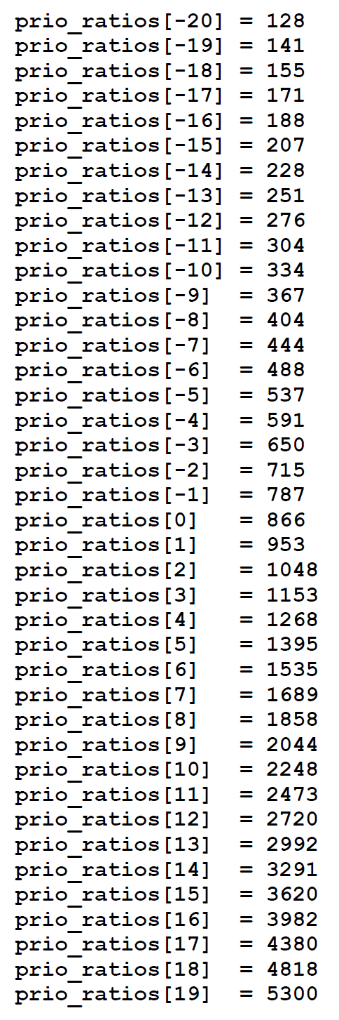
The parameters
“Scaling factor” is 8192
rr_interval is in millisecond while niffies are in nanosecond, hence the need for scaling. So need to scale by 1,000,000.
Need to divide by 128 is to reduce the magnitude of prio_ratio, so that at niceness -20, it will be effectively 1.
1,000,000 / 128 = 7,812.5. To optimize the computation, round to 8192 and use shifts instead of multiply.
“priority” maps -20 to +19 to 0 to 39 for array indexing
“prio_ratios” starts with 128 for niceness -20, scaled by 1.1 (with rounding to integer) thereafter.

Slide 152
How it works
Task exhausts timeslice:
task taken off the CPU
timeslice refilled
deadline recomputed
When a task sleeps:
Timeslice and deadline are untouched
Preemption by a newly woken task having higher priority or an earlier deadline than that of a currently running task’s:
New task takes over the processor

Slide 153
BFS finding the next task
Use the priority bit map trick to see what is the first queue that is non-empty
Then loop through the queue to find the task with the earliest deadline
New items are simply inserted to the end of the queue
Hence, O(n) to find an item

Slide 154
Isochronous and Idleprio scheduling
Isochronous scheduling (SCHED_ISO) designed to provide users without super user privileges with performance close to real-time
Priority higher than normal
A task requesting for realtime priority but lacks the privilege will be bumped to SCHED_ISO
A SCHED_ISO task needs superuser privilege to go back to normal
Scheduled in round robin with rr_interval timeslice
Idleprio for really low priority work – when system is idle
Example: run SETI@home

Slide 155
Skip List
A Digression
Source: M.T. Goodrich and R. Tamassia, UCI

Slide 156
What is a Skip List
A skip list of level h for a set S of distinct items is a series of lists S₀, S₁ , … , S_{h} such that
Each list S_{i} contains the special keys +∞ and −∞
List S₀ contains the keys of S in non-decreasing order
Each list is a subsequence of the previous one, i.e., S₀ ⊇ S₁ ⊇ … ⊇ S_{h}
List S_{h} contains only the two special keys
An example:
S₃
−∞
+∞
S₂
−∞
31
+∞
S₁
−∞
23
31
34
64
+∞
S₀
−∞
12
23
26
31
34
44
56
64
78
+∞

Slide 157
Search
We search for a key x in a skip list as follows:
We start at the first position of the top list
At the current position p, we compare x with y ← key(next(p))
x = y: we return element(next(p))
x > y: we “scan forward”
x < y: we “drop down”
If we try to drop down past the bottom list, we return null
Example: search for 78
S₃
−∞
+∞
S₂
−∞
31
+∞
S₁
−∞
23
31
34
64
+∞
S₀
−∞
12
23
26
31
34
44
56
64
78
+∞

Slide 158
Insertion
To insert an entry (x, o) into a skip list, we use a randomized algorithm:
We repeatedly toss a coin until we get tails, and we denote with i the number of times the coin came up heads
If i ≥ h, we add to the skip list new lists S_{h+1}, … , S_{i +1}, each containing only the two special keys
We search for x in the skip list and find the positions p₀, p₁ , …, p_{i} of the items with largest key less than x in each list S₀, S₁, … , S_{i}
For j ← 0, …, i, we insert item (x, o) into list S_{j} after position p_{j}
Example: insert key 15, with i = 2
S₃
−∞
+∞
p₂
S₂
−∞
+∞
S₂
−∞
15
+∞
p₁
S₁
−∞
23
+∞
S₁
−∞
15
23
+∞
p₀
S₀
−∞
10
23
36
+∞
S₀
−∞
10
15
23
36
+∞

Slide 159
Deletion
To remove an entry with key x from a skip list, we proceed as follows:
We search for x in the skip list and find the positions p₀, p₁ , …, p_{i} of the items with key x, where position p_{j} is in list S_{j}
We remove positions p₀, p₁ , …, p_{i} from the lists S₀, S₁, … , S_{i}
We remove all but one list containing only the two special keys
Example: remove key 34
S₃
−∞
+∞
p₂
S₂
−∞
34
+∞
S₂
−∞
+∞
p₁
S₁
−∞
23
34
+∞
S₁
−∞
23
+∞
p₀
S₀
−∞
12
23
34
45
+∞
S₀
−∞
12
23
45
+∞

Slide 160
Complexity
The expected space usage of a skip list is O(n)
A skip list with n entries has height at most 3log n with probability at least 1 - 1/n²
Expected times for search, insertion, deletion all of O(log n)

Slide 161
Improvements to BFS
In Sep 2011, Con Kolivas announced major changes to BFS
No more priority map and doubly-linked list
Instead global runqueue is a single skip list sorted by virtual deadlines
First task in the “bottom list” is the highest priority
Lookup is O(1)
Other tweaks yielded O(log n) insertion, O(1) lookup, and O(k) removal
k is the height of the node in question, up to 16, but usually only 1-4

Slide 162
Multiple Queue Skiplist Scheduler (MuQSS)
Released by Con Kolivas in Oct 2016
Problems with (original) BFS:
The single runqueue results in serious lock contention
O(n) lookup
Skiplist BFS solved 2
To solve 1, go back to one runqueue per CPU

Slide 163
MuQSS
Goal: Good desktop interactivity and responsiveness
Earliest Eligible Virtual Deadline First (EEVDF) policy
Multiple per-CPU runqueues
O(log n) insertion
O(1) lookup

Slide 164
Skiplists in MuQSS
Each processor has one runqueue
Each runqueue has one lock
Each runqueue has exactly 8 levels
Array of pointers to each level fits cache line size
Bidirectional skiplists
Can handle up to 256 tasks
Total number of tasks = 256 * number of logical CPUs

Slide 165
Virtual deadlines
“Niffies”: monotonic forward moving timer of nanosecond resolution
Implemented using high resolution TSC timers
Calculated per-CPU
Synchronous across CPUs
rr_interval: the longest duration two tasks of the same nice level will be delayed for
prio_ratio: a ratio compared to the baseline of nice -20 and increases by 10% per nice level
The virtual deadline is offset from the current time in niffies by this equation:
niffies + (prio_ratio * rr_interval)

Slide 166
Selecting a task
time_slice expiration: If a task runs out of its time_slice, it is descheduled, the time_slice is refilled, and the deadline reset to that formula
Sleep: time_slice and deadline not adjusted, carried over to the next time it is scheduled
Pre-emption: newly waking task is deemed higher priority than a currently running task on any CPU by virtue of the fact that it has an earlier virtual deadline than the currently running task

Slide 167
Operations
Task insertion: O(log n)
Ordering:
first by static priority, then
by virtual deadlines
Task lookup
Two modes: interactive and !interactive

Slide 168
interactive mode task lookup
Lockless read access to all CPU runqueues to pick one for possible scheduling
Suppose a candidate is found in CPU x’s runqueue. Perform a “trylock” on the chosen runqueue. If fail, go to 1.
If succeed, schedule that entry on oneself.

Slide 169
!interactive mode task lookup
Similar to interactive mode BUT
Only check runqueues of other CPU’s that are more heavily loaded than the current CPU
If current CPU most heavily loaded, look only at ownself runqueue

Slide 170
In summary
CFS regulates access by giving proportionate time to tasks according to priorities
BFS and variants implements priority via pre-emption and the frequency of a task’s access to the CPU

Slide 171
The End

